Slide 1
COMMODITY TRADE STATISTICS ANALYSIS
- MAŠINSKO UČENJE ZA DS -
Mihailo Joksimović, 2017/430059
UNIVERZITET SINGIDUNUM
DEPARTMAN ZA MASTER STUDIJE

Slide 2
Basic info
Global Commodity Trade Statistics Dataset obtained from Kaggle
Data from 1988 to 2016
Over 800k samples
98 categories and over 5000 commodities

Slide 3
Observations
Pretty good data set for EDA, but quite bad for ML
Problem – very few samples (max. 28 samples per commodity)

Slide 4
Variables
Name | Type
Country | Categorical
Year | Categorical*
Commodity code | Categorical
Flow | Categorical
Trade in USD | Quantitative
Weight in KG | Quantitative
Quantity Type | Categorical
Quantity | Quantitative
Category | Categorical

Slide 5
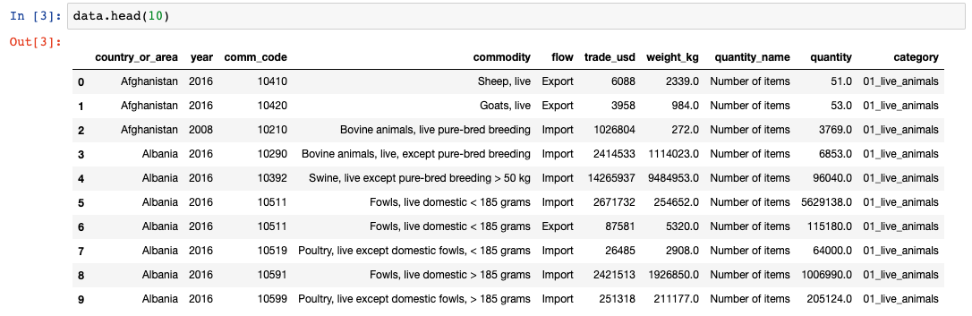
Dataset sample

Slide 6
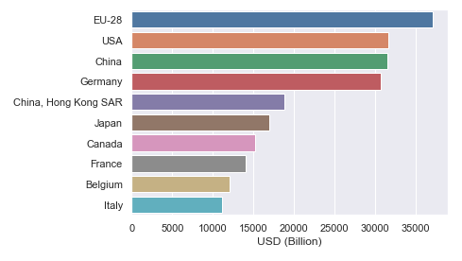
Countries with highest export

Slide 7
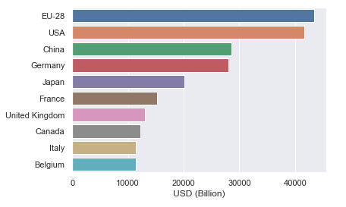
Countries with highest import

Slide 8
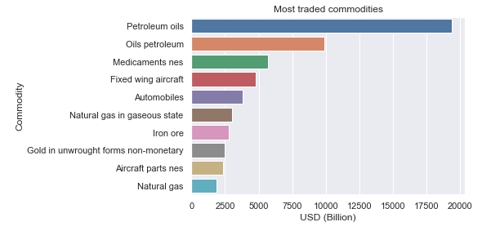
Most traded commodities

Slide 9
Serbian data

Slide 10
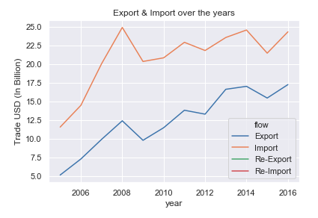
Export & Import over the years

Slide 11
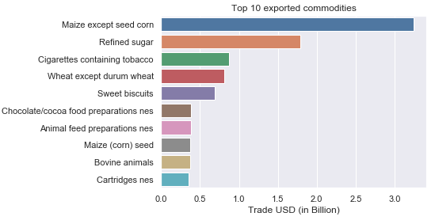
Most exported commodities

Slide 12
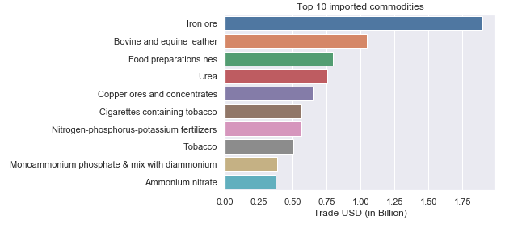
Most imported commodities

Slide 13
Predictions

Slide 14
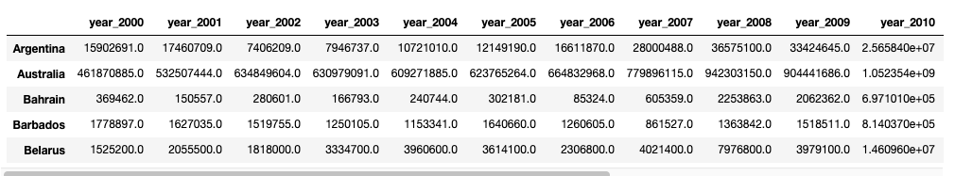
Clustering based on animal trade
Idea: Cluster countries based on “live animals” category trade over the years

Slide 15
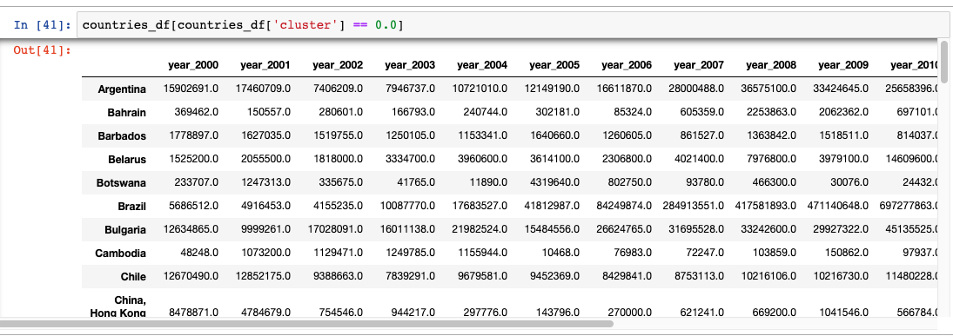
kNN clustering (k = 3) – First cluster

Slide 16
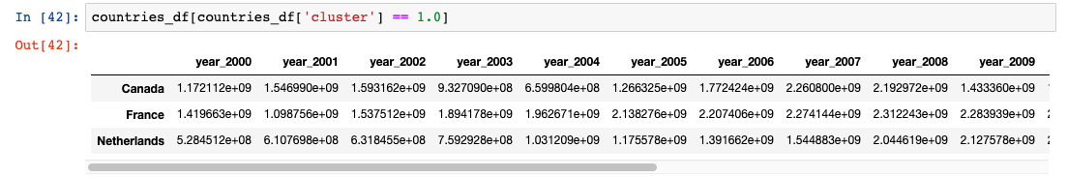
kNN clustering (k = 3) – Second cluster

Slide 17
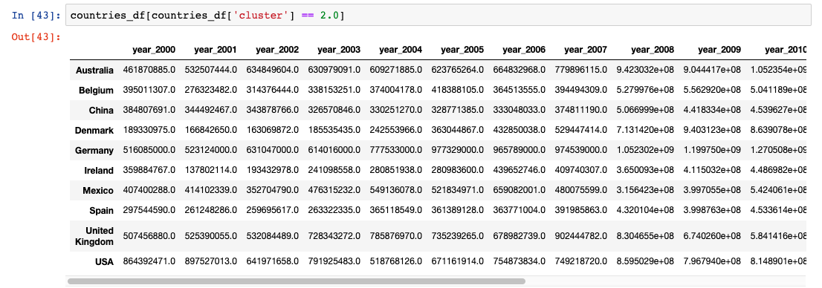
kNN clustering (k = 3) – Third cluster

Slide 18
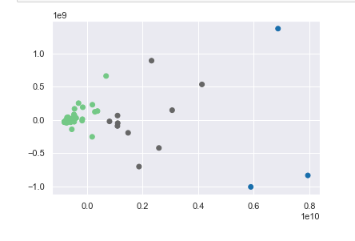
PCA dimensionality reduction
Visualizing the dataset using PCA shows pretty messy data

Slide 19
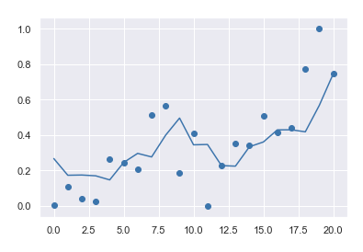
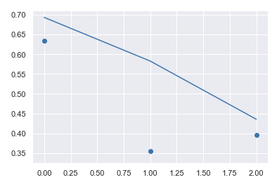
SVM prediction
Train set
Test set

Slide 20
Conclusion
Dataset was pretty good for EDA
Not enough data and definitely not enough variables to explain variation
Consequence - pretty bad models

Slide 21
References
https://www.kaggle.com/unitednations/global-commodity-trade-statistics
https://github.com/MihailoJoksimovic/commodity-trade-statistics-analysis

